Slide 1
PRAVALIKA NAYANA
Employee Id: 153017
Java Full Stack, MIPL.

Slide 2
TEAM MEMBERS:
Vinitha Neeli
Pravalika Nayana
Khishore Kumar
Archana Emmadi

Slide 3
CapStore Shopping Application

Slide 4
Project Requirements

Slide 5
Softwares:
Java 10
STS Version: 3.9.4.RELEASE
MySQL 5.5 Command Line Client
HTML 5
CSS 3
BootStrap
JavaScript
JSP
Spring Boot (2.0.4)
Spring Rest
Notes:
Fixar a posicao do titulo – sempre do lado esquerdo.
Sempre que tiver muito texto o coluna deve sempre ser “ narrowed” , se nao fica dificil de ler. Colocar paragrafos no texto.
Linha vertical deve ser mais fina e as pontas NUNCA devem ser arredondadas.

Slide 6
MODULE:
TRANSACTION PROCESSING

Slide 7
User balance deduction after payment:
When the user commits payment after providing the details, the bill amount is deducted from the user bank account.
Based on the transaction Id generated in the transaction table, the bill amount is brought.
This amount is deducted from the customer’s account in BankAccount table.

Slide 8
Calculating CapStore Revenue:
Admin chooses to get the CapStore revenue for a particular time period by giving from and to dates in ‘getRevenue’ page.
Then the revenue is calculated by summing up the amount in transaction table between two dates given by the admin.

Slide 9
Tables Used
Bank Account
bankAccountId
customerId
accountNumber
cardNumber
balance
cvvNumber
Transaction
transactionId
amount
modeOfPurchase
status
transactionDate
orderId

Slide 10
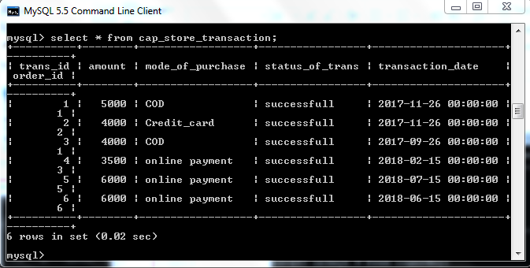
Transaction table:

Slide 11
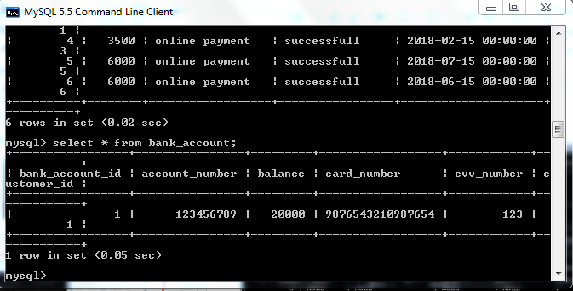
BankAccount table:

Slide 12
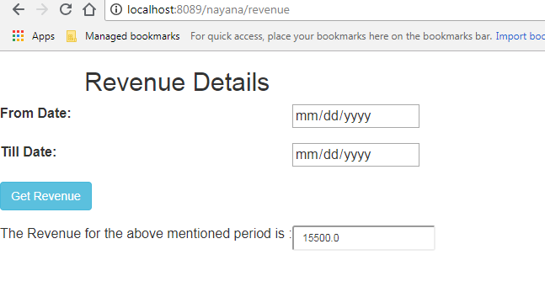
Output:

Slide 13
Thank You
Notes:
O Box atras do texto desnecessario. Deixar o layout mais simples.

